Slide 1
Bulk CUT&Tag Data Analysis
Hanrong Hu, Fides Zenk

Slide 2
Perquisites
Install conda
Install macs3 and deepTools:
(optional but recommended): install to specific conda environment
conda create -n epign_practical -c bioconda macs3 deeptools
Install R & Rstudio, and required packages:
ChIPseeker
TxDb.Hsapiens.UCSC.hg38.knownGene
org.Hs.eg.db

Slide 3
Bulk NGS data analysis
Glossary of NGS terms: https://deeptools.readthedocs.io/en/develop/content/help_glossary.html#
Data pre-processing
(FASTQ files)
Alignment
(SAM files)
Conversion & filtering
(BAM files)
Coverage files
(BigWig files)
Peak calling
(BED files)
Get a small(er) file to work with
What we typically get from the sequencing facility
Filter by mapping quality, duplicates etc.
Can also align to a hybrid genome (e.g spike-in, GFP)
Find regions of enrichment

Slide 4
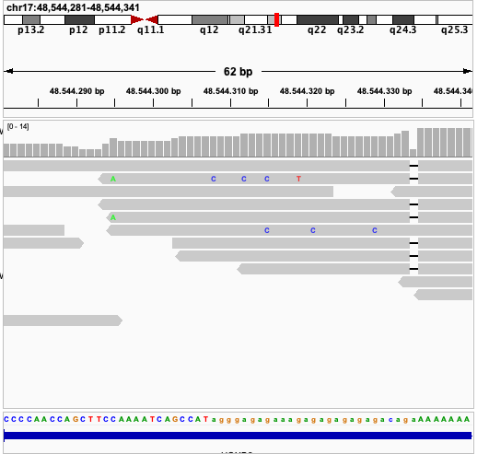
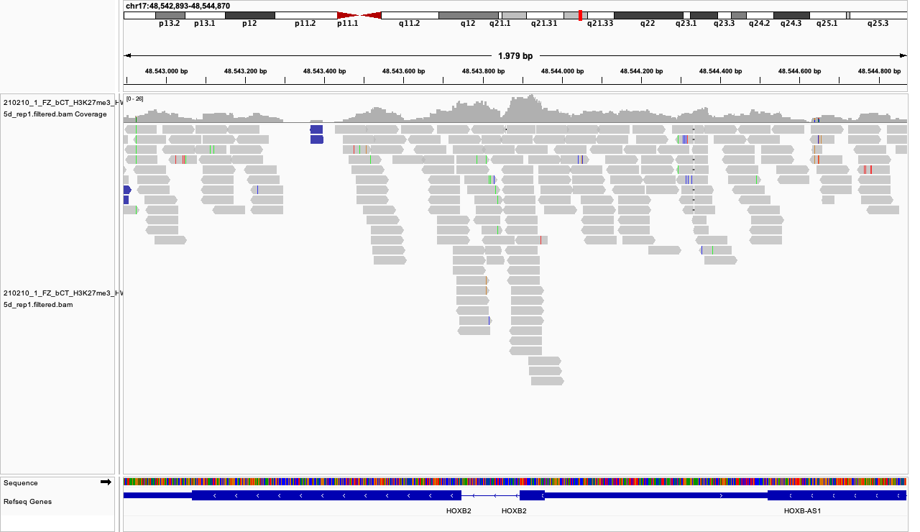
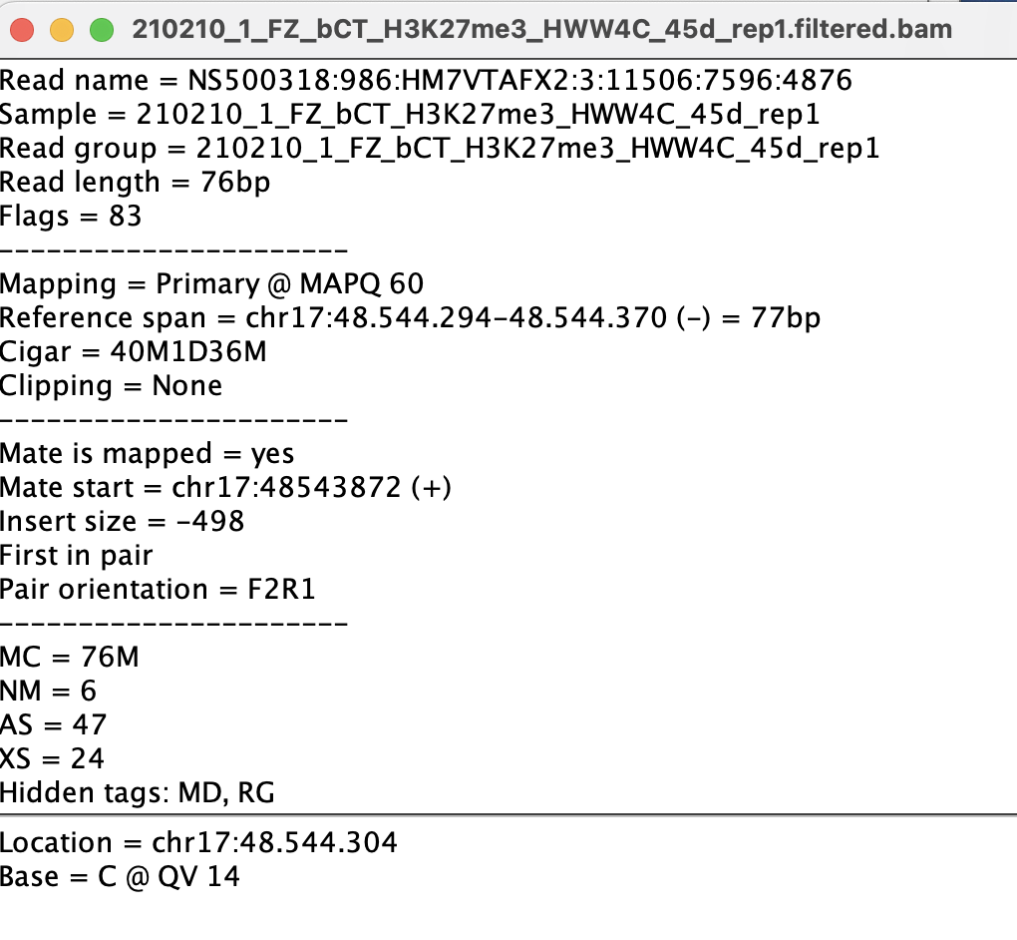
Working with BAM files (1)
Each read nucleotide seq&stats is available

Slide 5
Working with BAM files (2)
BAM to BW
BigWig file format: a coverage file
Check deepTools bamCoverage
Peak calling from BAM files
Peak calling: identify areas of enriched signals
Check macs3 callpeak
macs3 callpeak -t reads.bam -f BAM --broad -g hs \
--outdir MACS3_broad_peaks -B --broad-cutoff 0.1 --nolambda

Slide 6
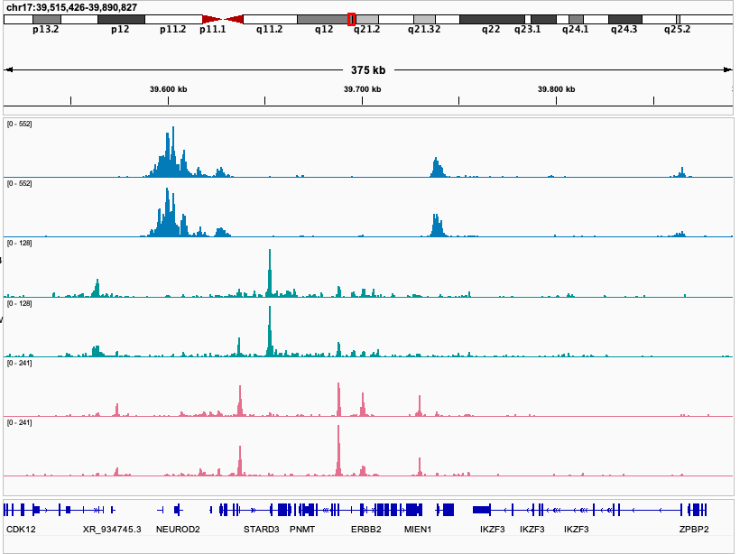
Working with BW files (1)
45d brain organoids
Load BW into IGV
Visually check BW files
Signal-to-noise ratio?
Are signals enriched in expected genomic regions?
Are replicates look good?
H3K27me3
H3K27ac
H3K4me3

Slide 7
Working with BW files (2) - deepTools
regions | sample1 | sample2
chr1:1-1000 | 0 | 10
chr1:1001-2000 | 3 | 3
… | … | …
multiBigwigSummary
get signals (BW) on regions
(tips): .npz matrix can be loaded in python
plotCorrelation or plotPCA
# from BW files
multiBigwigSummary bins -b file1.bw file2.bw -o results.npz
# PCA
plotPCA -in results.npz -o pca.png
Example: ex vivo xenopus laevis in 96-well or air-liquid-interface
(re-plotted in python)

Slide 8
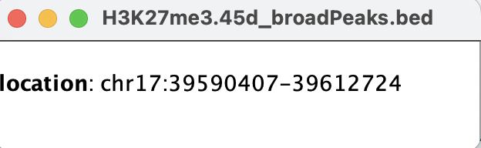
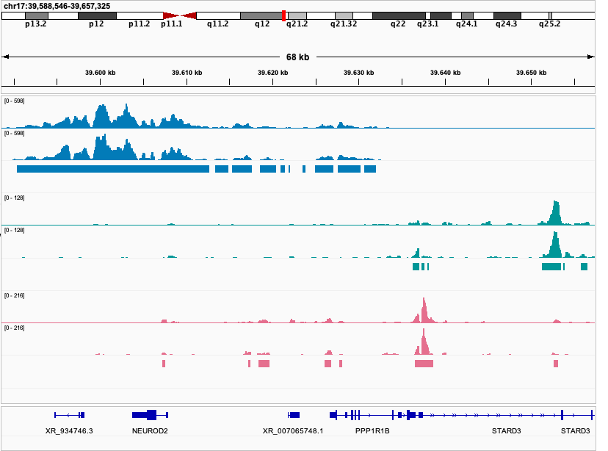
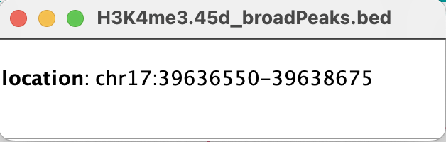
Working with peak files (1)
45d brain organoids
BED format
#chrom, chromStart, chromEnd, name …
Load peak files into IGV
Are peaks too noisy?
Does enrichment in BW fall into peak regions?
Do replicates look consistent(ish)?
H3K27me3
H3K27ac
H3K4me3

Slide 9
Working with peak files (2) - bedtools
BED file manipulation: bedtools
bedtools are also available in EPFL HPC clusters
Most common ones: intersect, merge
# intersect >1 BED files
## check the option from manual
bedtools intersect -a file1.bed -b file2.bed file2.bed
# merge overlapping intervels
bedtools merge –i file.bed –d 150 # two regions less than 150 bp apart will be merged

Slide 10
Visualize signals (BW) on peaks
H3K27me3
H3
Cond 1
Cond 2
Cond 1
Cond 2
computeMatrix and plotHeatmap
computeMatrix reference-point \
-S coverage.bigwig -R regions.bed -o matrix.gz
plotHeatmap -m matrix.gz -o heatmap.png
H3K27me3 peaks
Check this matrix dimension:
zcat matrix.gz | head -n 2
zless matrix.gz | head -n 2
Example: mouse proximal limb ex-vivo culture

Slide 11
Visualize signals (BW) on other regions
H3K4me3
H3
Cond 1
Cond 2
Cond 1
Cond 2
computeMatrix with another mode: scale-region
E.g. transcriptional start site (TSS) https://reftss.riken.jp
Mouse (mm39) TSS
computeMatrix scale-region \
-S coverage.bigwig -R TSS.bed -o matrix.gz
plotHeatmap -m matrix.gz -o heatmap.png
Example: mouse proximal limb ex-vivo culture

Slide 12
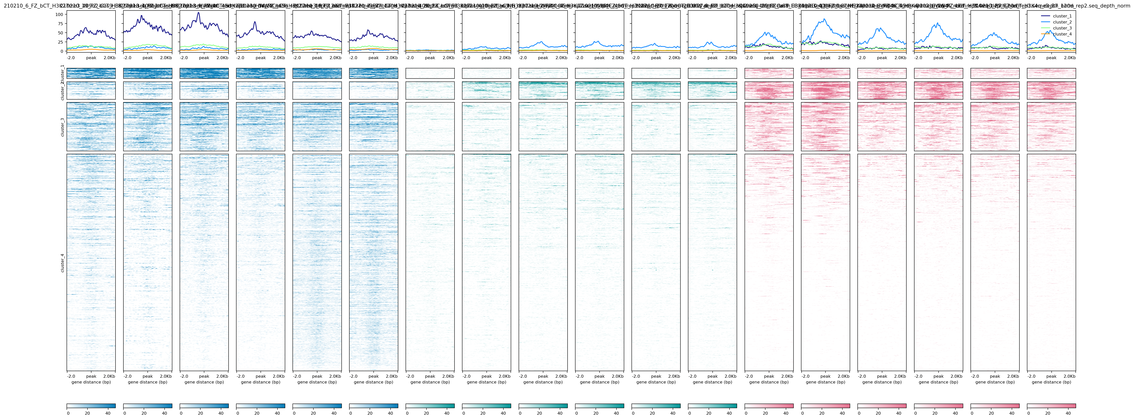
Cluster analysis
computeMatrix scale-regions -S coverage.bigwig \
-R regions.bed -o matrix.gz
plotHeatmap -m matrix.gz \
--kmeans 4 \ # other clustering algorithm possible
--outFileSortedRegions heatmap_sortedRegions.bed \
--outFileNameMatrix cluster_martrix.gz \
-o heatmap.png
Clustering of matrix.gz
H3K27me3
H3K27ac
H3K4me3
EB
d15
d45
d120
EB
d15
d45
d120
EB
d15
d45
d120
Union of H3K27me3 peaks on chr7

Slide 13
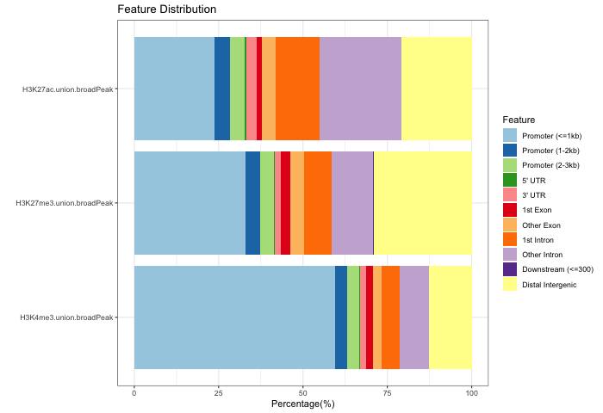
Functional annotation
From BED files to the functions
H3K4me3 peaks → promoters?
Regions with H3K27ac & H3K4me1 → enhancers ?
Regions lose H3K4me3 over development → ??
ChIPseeker in R
library(ChIPseeker)
library(TxDb.Hsapiens.UCSC.hg38.knownGene)
library(org.Hs.eg.db)
# Specify the TxDb object correctly
txdb <- TxDb.Hsapiens.UCSC.hg38.knownGene
# Convert to GRanges object and assign names
CnT.gr <- setNames(lapply(CnT.peaks, readPeakFile), peak_names)
# Annotate
CnT.anno <- lapply(CnT.gr, function(peak.gr){
annotatePeak(peak.gr, tssRegion = c(-3000, 3000), TxDb = txdb,
annoDb = "org.Hs.eg.db")
})
# Plot the stats
plotAnnoBar(CnT.anno)

